Slide 1
SERVE TO CHANGE LIVES
EMPOWERING GIRLS
A 2021-22 Presidential Initiative

Slide 2
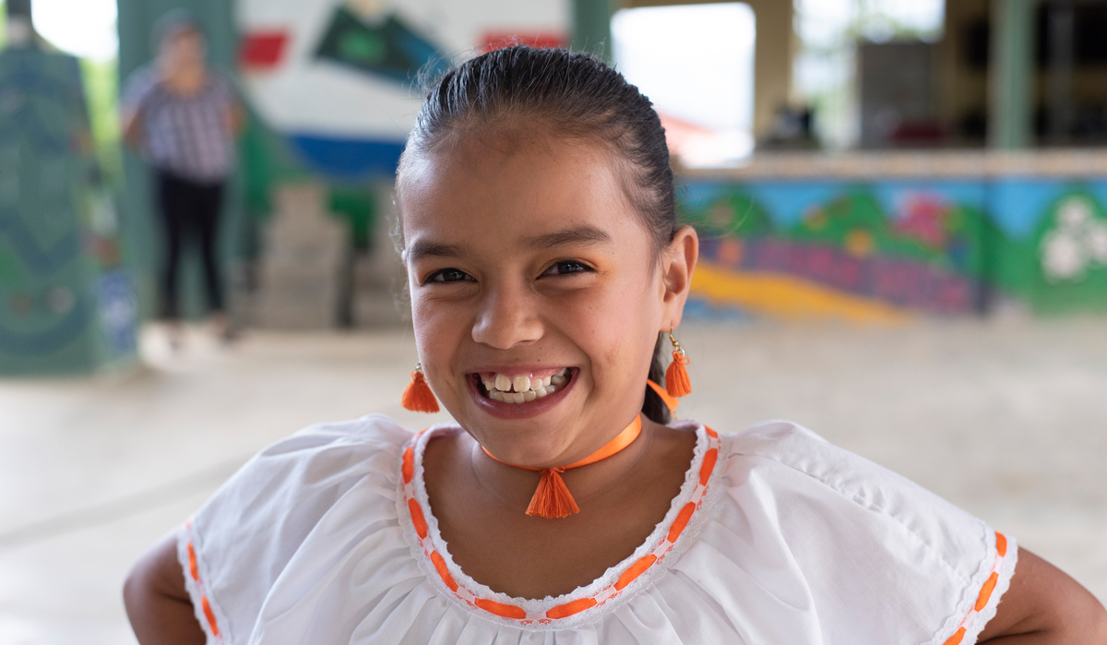
The Empowering Girls Initiative
Why empower girls?
It makes families healthier.
Educated girls have better-educated children and earn higher wages, helping get their families out of poverty.
Women participating in the labor market at the same rate as men would add up to $28 trillion to the annual global gross domestic product in 2025, shares the World Economic Forum.
Every girl should be in charge of her own future. We have an obligation to protect girls’ rights and promote their well-being.
Through the Empowering Girls Initiative, Rotary members worldwide can enhance girls’ safety, health, education, and well-being.

Slide 3
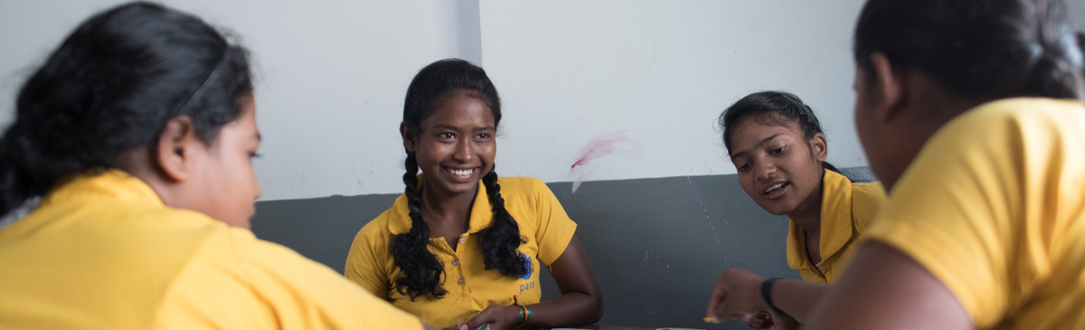
A preference for sons
A preference for sons can lead to sex selection through abortion, infanticide, and other means.
The world population is believed to lack an estimated 140 million women because of parents’ preference for sons.
Since the 1990s, in some regions, up to 25% more males have been born than females.
In more than 5 of 6 countries with available data, girls ages 10-14 are more likely than boys of the same age to spend 21 or more hours per week on household chores.
Sources: unfpa.org/gender-biased-sex-selection and data.unicef.org/topic/gender/covid-19/
Notes:
Source: unfpa.org/gender-biased-sex-selection
Source: data.unicef.org/topic/gender/covid-19/

Slide 4
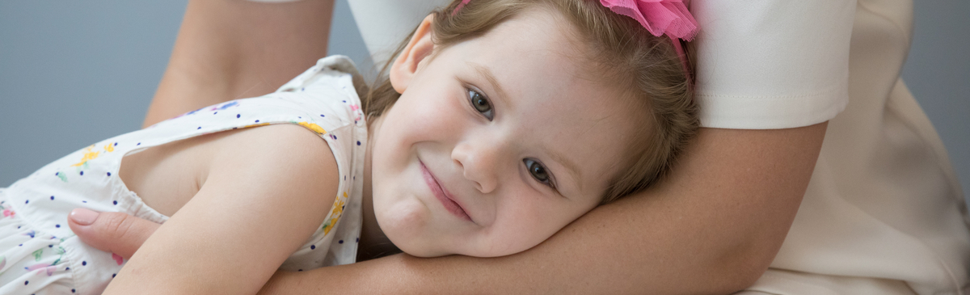
Health and nutrition
In the past two decades, only minimal progress has been made in reducing the number of girls ages 5-19 who are moderately or severely underweight.
In South Asia, where virtually no progress has been made since 1995, 1 in 5 girls is moderately or severely underweight.
The proportion of girls ages 5-19 who are overweight has nearly doubled since 1995, from 9% to 17%.

Slide 5
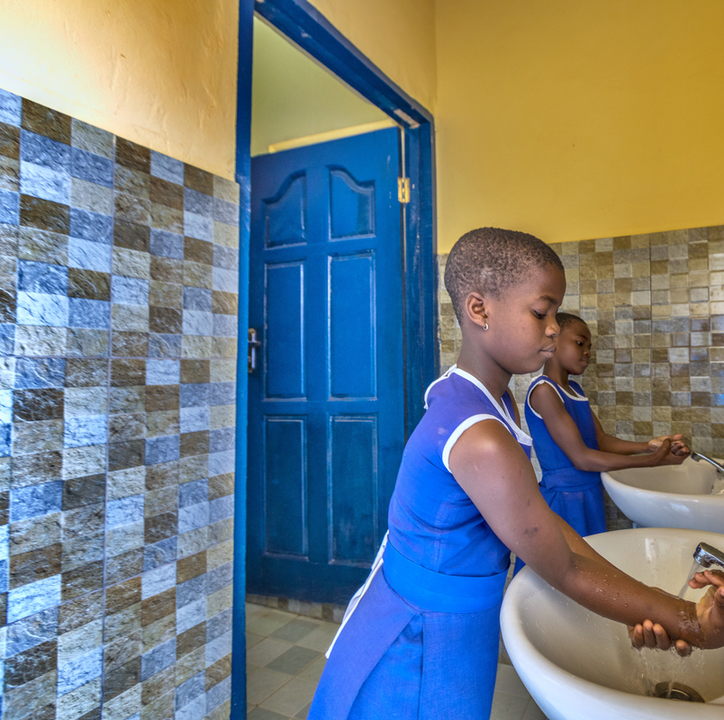
Health and hygiene
The number of girls ages 10-19 who are living with HIV has increased 31% since 1995. It's now 970,000.
Globally, 500 million women and girls lack adequate facilities to properly manage their menstrual hygiene.
Research finds that girls’ inability to manage their menstrual hygiene in schools leads to absenteeism, which then has severe economic costs, both personally and societally.
Source: unicef.org

Slide 6
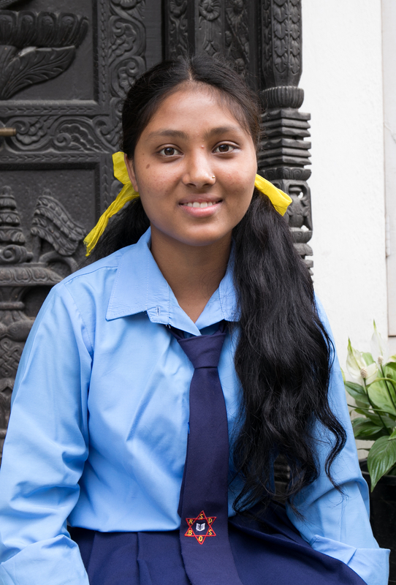
Child marriage
1 in 5 girls around the world marries before age 18.
Without stronger efforts to end child marriage, more than 120 million girls under age 18 will marry by 2030.
Putting an end to child marriage would increase women’s educational attainment and, with it, their potential earnings. It’s estimated that ending child marriage could generate more than $500 billion in benefits annually.
Sources: unicef.org/protection/child-marriage and unfpa.org/swop-2020#!/fgm-3

Slide 7
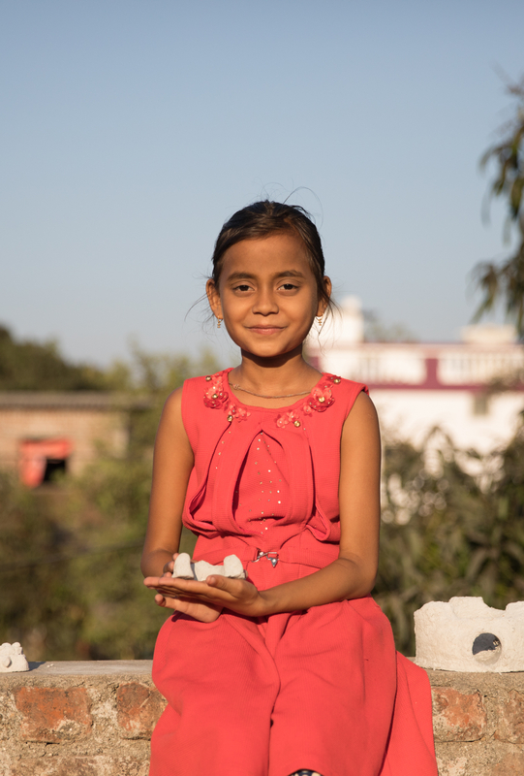
Female genital mutilation
Female genital mutilation has been performed on at least 200 million girls and women in 31 countries across three continents.
More than half of the affected girls live in Egypt, Ethiopia, or Indonesia.
Each year, more than 4 million girls are at risk of genital mutilation. Most girls undergo it before age 15.
Source: unicef.org/female-genital-mutilation

Slide 8
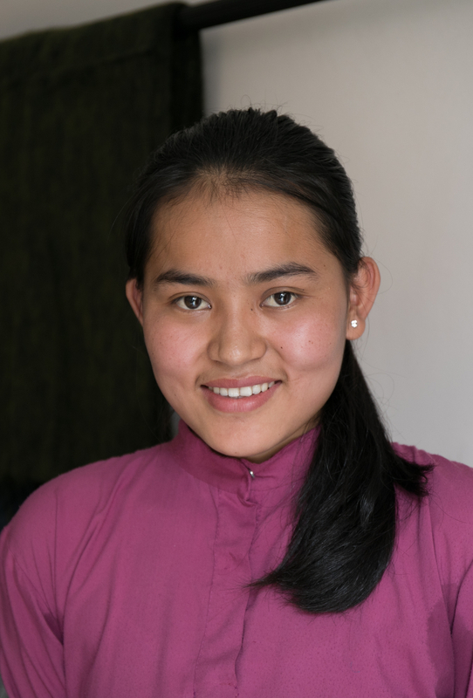
Adolescent pregnancy
Complications during pregnancy and childbirth are the world’s leading cause of death for girls ages 15-19.
Approximately 12 million adolescents ages 15-19 and at least 777,000 who are under 15 give birth in developing regions each year.
Babies of adolescent mothers face higher risks of preterm delivery, low birth weight, and severe neonatal conditions.

Slide 9
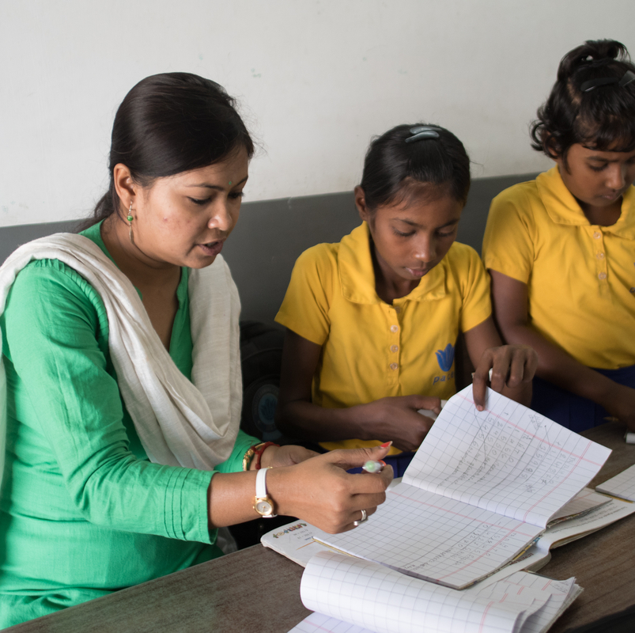
Education and skills
The United Nations says 60 million girls worldwide have no access to basic education.
Of the 960 million people who are illiterate worldwide, two-thirds are women.
In many regions, schools do not meet the safety, hygiene, or sanitation needs of girls.
Globally, 1 in 4 girls ages 15-19 are neither employed nor in school, compared with 1 in 10 boys.
Source: unicef.org/gender-equality
Notes:
If a girl completes her secondary education, the long-term benefits include lower fertility and higher labor force participation. The cost of interventions during adolescence or earlier tends to be lower than the cost of interventions implemented later.
In low-income countries, substantial gender gaps persist in basic education — especially at the secondary level, where the completion rate for girls, at just under 37%, is below that of boys.

Slide 10
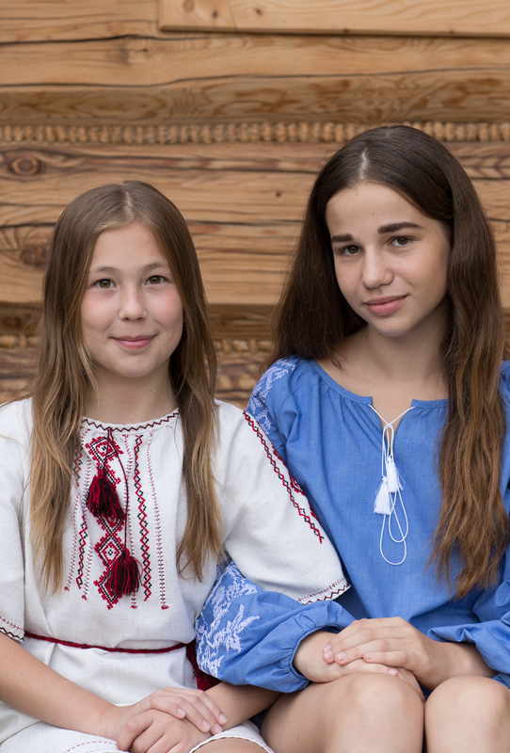
Violence against girls
Of all human trafficking victims, 51% are women and 20% are girls.
1 in 20 girls ages 15-19, about 13 million globally, have been subjected to forced sex.
Every year, an estimated 60 million girls are sexually assaulted on their way to school or at school.
Nearly 4 in 10 adolescent girls think wife-beating is justified in some circumstances.
Sources: un.org/sustainabledevelopment/blog/2016/12/report-majority-of-trafficking-victims-are-women-and-girls-one-third-children/, Unicef.org, worldbank.org/girlseducation

Slide 11
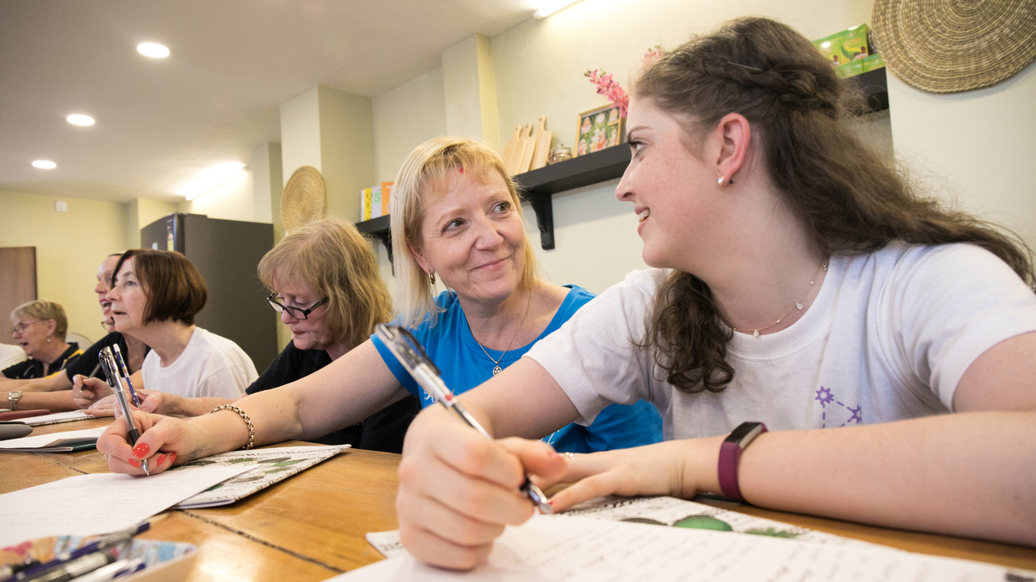
WHAT CAN ROTARY DO?
Rotary clubs and districts can participate by creating and implementing projects that enhance the quality of life for girls and improves girls’ chances of enjoying safe, healthy, and productive lives. They can also modify existing projects to include components that focus on empowering girls.
What challenges do girls face in our community?
How can our club work with communities to find solutions to these challenges?
What cultural norms in our area might keep girls from attending school?
Which local organizations can we work with on projects that empower girls?
How can we raise awareness of the need to empower girls within our communities and among our partners?
Does our club empower women to take leadership roles?

Slide 12
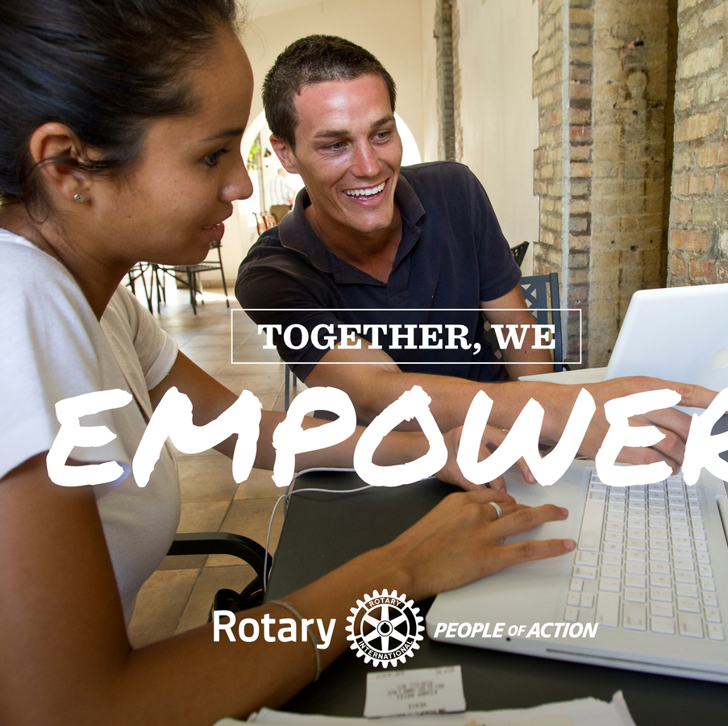
Resources
Empowering Girls ambassadors
Advocate for girls’ empowerment.
Act as a resource for clubs and districts.
Collect and distribute success stories.
Opportunities
Visit the RI president’s page to find ways to participate.
Attend a presidential conference.
Learn more about Rotary’s comprehensive approach to youth protection.
Rotary Action Groups
Find contact information on the RI president’s page.
Connect with action groups that can help.
The Cadre of Technical Advisers
Find an adviser who can help with initiatives to empower girls by writing to cadre@rotary.org.
Rotary Showcase
Find ideas for projects or ways to work with other clubs to empower girls.
Add your service activity or project to the Empowering Girls Campaign at Empowering Girls 2021 or EG2021.
Partnerships
Work with our partner, the Global Partnership for Education, on projects that increase girls’ access to education.

Slide 13
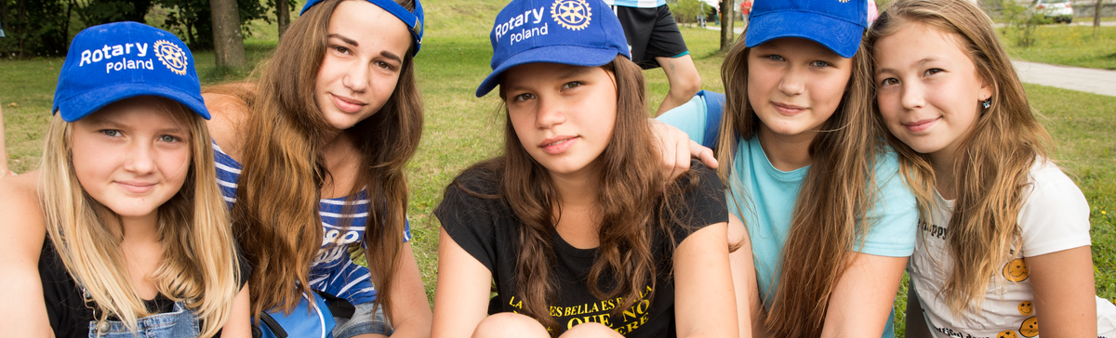
The legacy of empowering girls
The Empowering Girls initiative should be the start of Rotary making a lasting impact on a generation of girls.
We can make a difference in girls’ lives by:
  Advocating for the public and private sectors to support girls
  Raising awareness of girls’ needs in our communities, our social networks, and our partnerships — as we’ve done with our polio-eradication work

Slide 14

Thank you!

