Slide 1
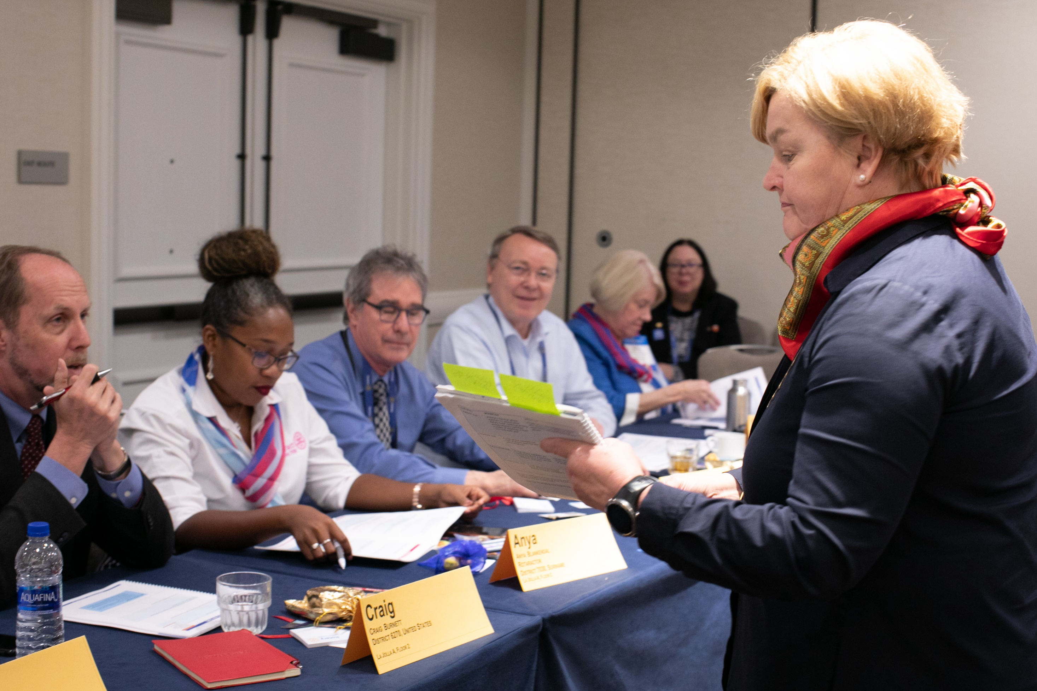
Rotary training: what we learned in 2020-21

Slide 2
Definitions

Slide 3
Get Started with the Learning Center
Get Ready: Club President
My Rotary: Club Administration
Harassment
BLENDED LEARNING
Blended learning combines online and in-person study.
It can include courses in Rotary’s Learning Center, in-person learning events, and virtual meetings.

Slide 4
Get Started with the Learning Center
Get Ready: Club President
My Rotary: Club Administration
Harassment
HYBRID LEARNING EVENTS
In hybrid learning events, some participants attend in person and others learn virtually. Those who learn virtually might all participate at the same time, along with the in-person participants, or they might be offered sessions at a different time.
Notes:
In hybrid learning events, some participants attend in person while others attend virtually.
When everyone participates in learning at the same time, it is called synchronous learning.
You can also hold in-person events while offering an asynchronous virtual option

Slide 5
Get Started with the Learning Center
Get Ready: Club President
My Rotary: Club Administration
Harassment
TRAINING
vs.
LEARNING
Training is the giving of information and knowledge. We can train others in doing specific tasks or train them in skills through demonstration, explanation, or other methods.
Training is done to the participant.

Slide 6
Get Started with the Learning Center
Get Ready: Club President
My Rotary: Club Administration
Harassment
TRAINING
vs.
LEARNING
Learning is absorbing information in order to increase skills and abilities. Examples of ways people learn include reading about a topic, discussing ideas, or practicing a skill.
Learning is what a participant does.

Slide 7
What we learned
from training events in 2020-21
Notes:
What follows is what we learned from a combination of training event evaluations, broader surveys of our members, and research led by the Learning and Development Committee.

Slide 8

Offer more self-directed learning rather than required training
Notes:
Participant-centered learning brings more value to Rotary membership. This approach better engages participants in building their skills and knowledge and allows them to learn from one another. When you offer learning opportunities that members want and need, they’ll be eager to learn.
Learning Center courses, My Rotary resources, and how to guides should be used at an early stage of any learning process, because they provide basic knowledge as well as needed technical and professional skills. Then participants can use live sessions to share their experiences, practice their skills, and plan ways to drive action.

Slide 9
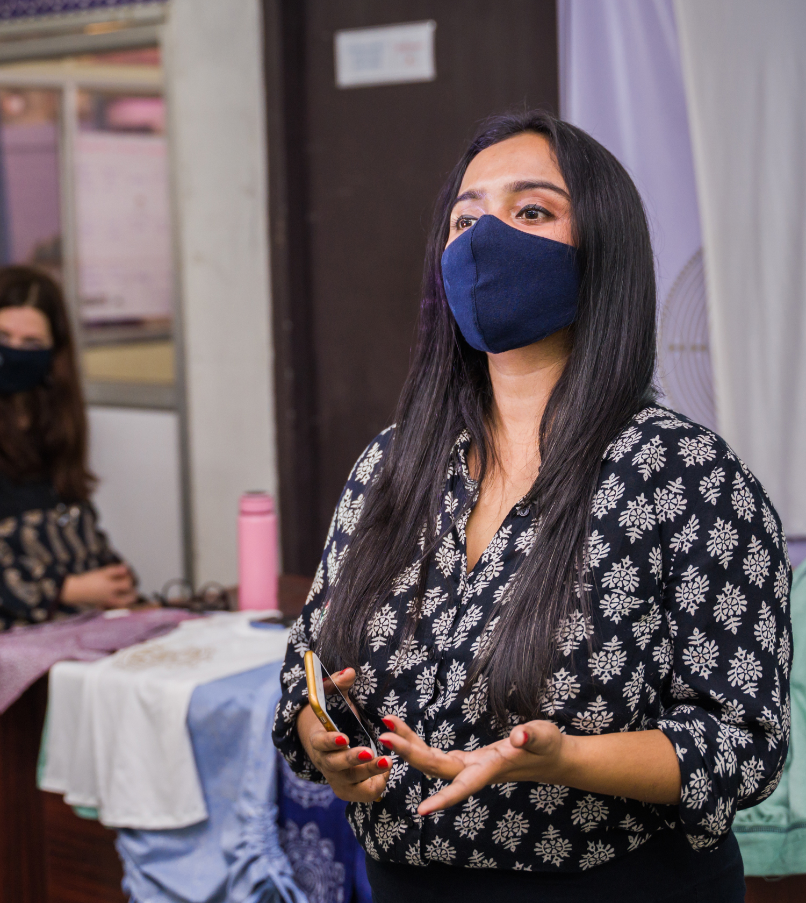
Use skilled facilitators
Notes:
To create an engaging learning environment, you need skilled facilitators. They should work closely with experts in the topic.
Instead of simply presenting information that participants could learn from a training manual or online resources before the session, experts should answer questions. Facilitators should lead the discussion and prompt participants to share their experiences and learn from one another.

Slide 10
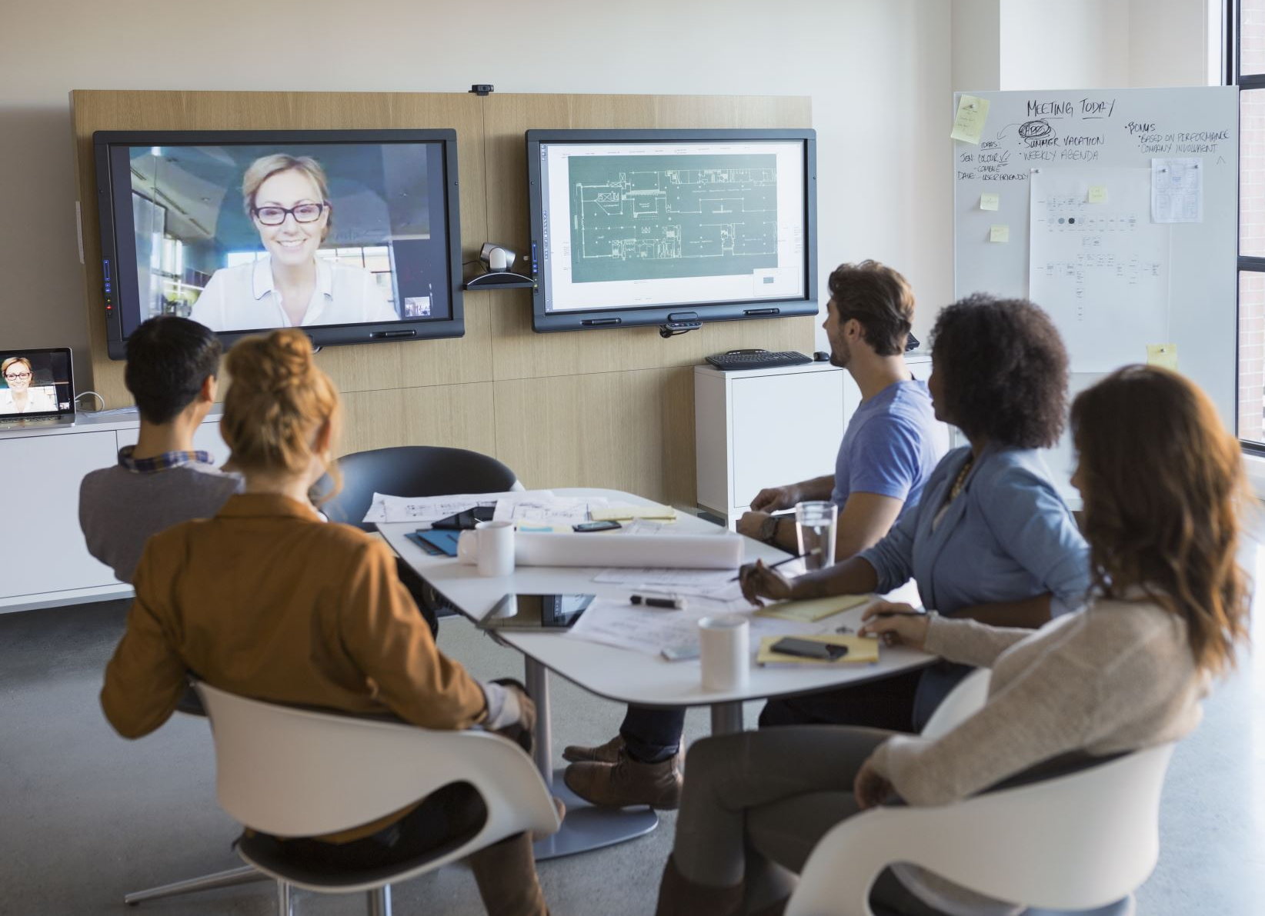
Offer learning events that are flexible and responsive to participants’ needs
Notes:
As you think about the format of your meeting, consider factors such as safety, the cost-effectiveness of in-person and virtual events, and demands on members’ time.
For in-person events, consider options such as holding several smaller meetings in multiple locations while live-streaming general sessions from a central location. For hybrid events, consider live-streaming general sessions and hosting separate breakout sessions for in-person and virtual participants.

Slide 11

Include Rotaractors
Notes:
Rotaractors are Rotary members, so make sure to include them in your events. But don’t just invite them. Ask them what they want to learn and then work with them to address their needs.
Ask Rotaractors to serve on planning committees, too. And be sure to consult with your district Rotaract representative when planning. You'll want to find out if their needs and interests differ from those of Rotarians.

Slide 12
Courses completed by year
Use Rotary Learning Center courses to build basic knowledge first
Notes:
Starting with Learning Center courses to prepare participants can make later live events more effective. If you choose courses that cover the basics of a topic, your participants will all share that knowledge when the event begins. Then, whether you lead an in-person or virtual event, it can go deeper into the topics that are most relevant in your region and can include more time for participants to exchange ideas for applying what they’ve learned.
The Learning Center is a valuable tool in blended learning. Many people don’t know about all that it offers, so promote its benefits by urging participants to explore topics other than those you cover.
As the slide shows, use of the Learning Center has increased dramatically during the pandemic. In 2019-20, most of the courses were completed in the second half of the year. This year, use was steady throughout the year, and almost 20,000 more courses were completed in 2020-21.

Slide 13

maximize
the value of
in-person events
Notes:
In-person events do offer some advantages, and we now have an opportunity to evaluate how we conducted them in the past so that we can do better as we return to in-person events.
Use time in-person to let participants share ideas and to prepare them to take action after the event.
Make sure you include informal learning opportunities at breaks and meals. What participants learn at those times can have as large an impact as what they learn during sessions.
In-person events should also be focused. With the shift to virtual events, some districts that used to combine several meetings into one event instead hosted meetings with a single purpose, focusing on one audience at a time. Consider this option when you plan in-person events as well.

Slide 14

consider
Where the participants are
Notes:
When you plan, make sure to consider where all your participants are, whether the event will be in-person or virtual. Ask them what time of day they prefer to meet, and consider what time zones they’re in, especially when you schedule breakout sessions.

Slide 15

Provide additional support for virtual events
Notes:
Over the past year, we learned that virtual events require additional types of support. All speakers need practice and support in giving virtual presentations. Each room needs a facilitator, a backup facilitator, and a tech support person. And every event should have a help desk so participants can ask technological questions.
Limit breakout rooms to 15 people so everyone can see one another on their screens.

Slide 16

Be Prepared
Notes:
We also learned that preparation matters. Facilitators must rehearse — and not just what they will say. They should check the lighting, decide whether they will sit or stand, and make sure they’re familiar with the computer equipment and software they’ll use.
Remember also to have security protocols in place and to follow them.
Finally, organize all of your information and resources in one place, such as a virtual event platform that lists dates, times, and links to the sessions. Don’t make participants search their email for links or for answers to simple questions, such as when a session starts.

Slide 17

Make sure you have enough time to Plan
Notes:
We learned that planning a virtual or hybrid event may take longer than you expect. Start planning early, and make key decisions early. You’ll also need more rooms than you would prior to the pandemic. Virtual breakouts should be able to include everyone’s video on one screen, and in-person sessions will need to be more spread out.

Slide 18

Focus on what’s MOST important
Notes:
When you ask participants to take courses in the Learning Center before an event, you can then present more customized content whether it’s online or in-person. This allows for in-person meetings to be shorter and keeps virtual participants from being in front of a screen for too long. Trainers should also complete those courses so that they know exactly what participants have learned and can build on it.
For example, many events before the presidents-elect training seminar (PETS) offer a session called “What Is The Rotary Foundation?” If participants complete the Rotary Foundation Basics course in the Learning Center before that, they’ll be ready to share ideas on how to help members make the most of Foundation programs and grants.

Slide 19

Break Virtual events into a number of sessions
Notes:
We learned that, with virtual learning events, it’s better to hold several short sessions over a few days than to host an all-day event. For example, a meeting that might have been scheduled as one six-hour in-person session could be broken into 60- to 90-minute virtual sessions that are scheduled over three or four weeks or during one long weekend. Try not to exceed two hours of virtual sessions on any one day.

Slide 20
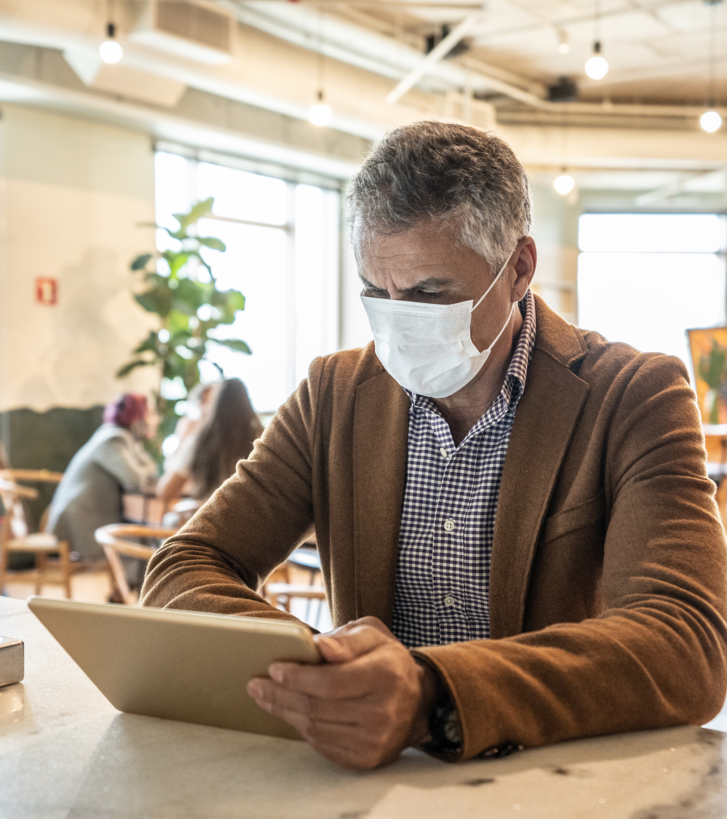
Keep Virtual general sessions short
Notes:
Whether online or in-person, the ideal length for a general session is about 45 minutes, with 60 minutes as the maximum, so keep your message concise and focused.
If your session is virtual, consider recording separate videos for each speaker to make it easy for people to watch a particular speaker again after the event.

Slide 21
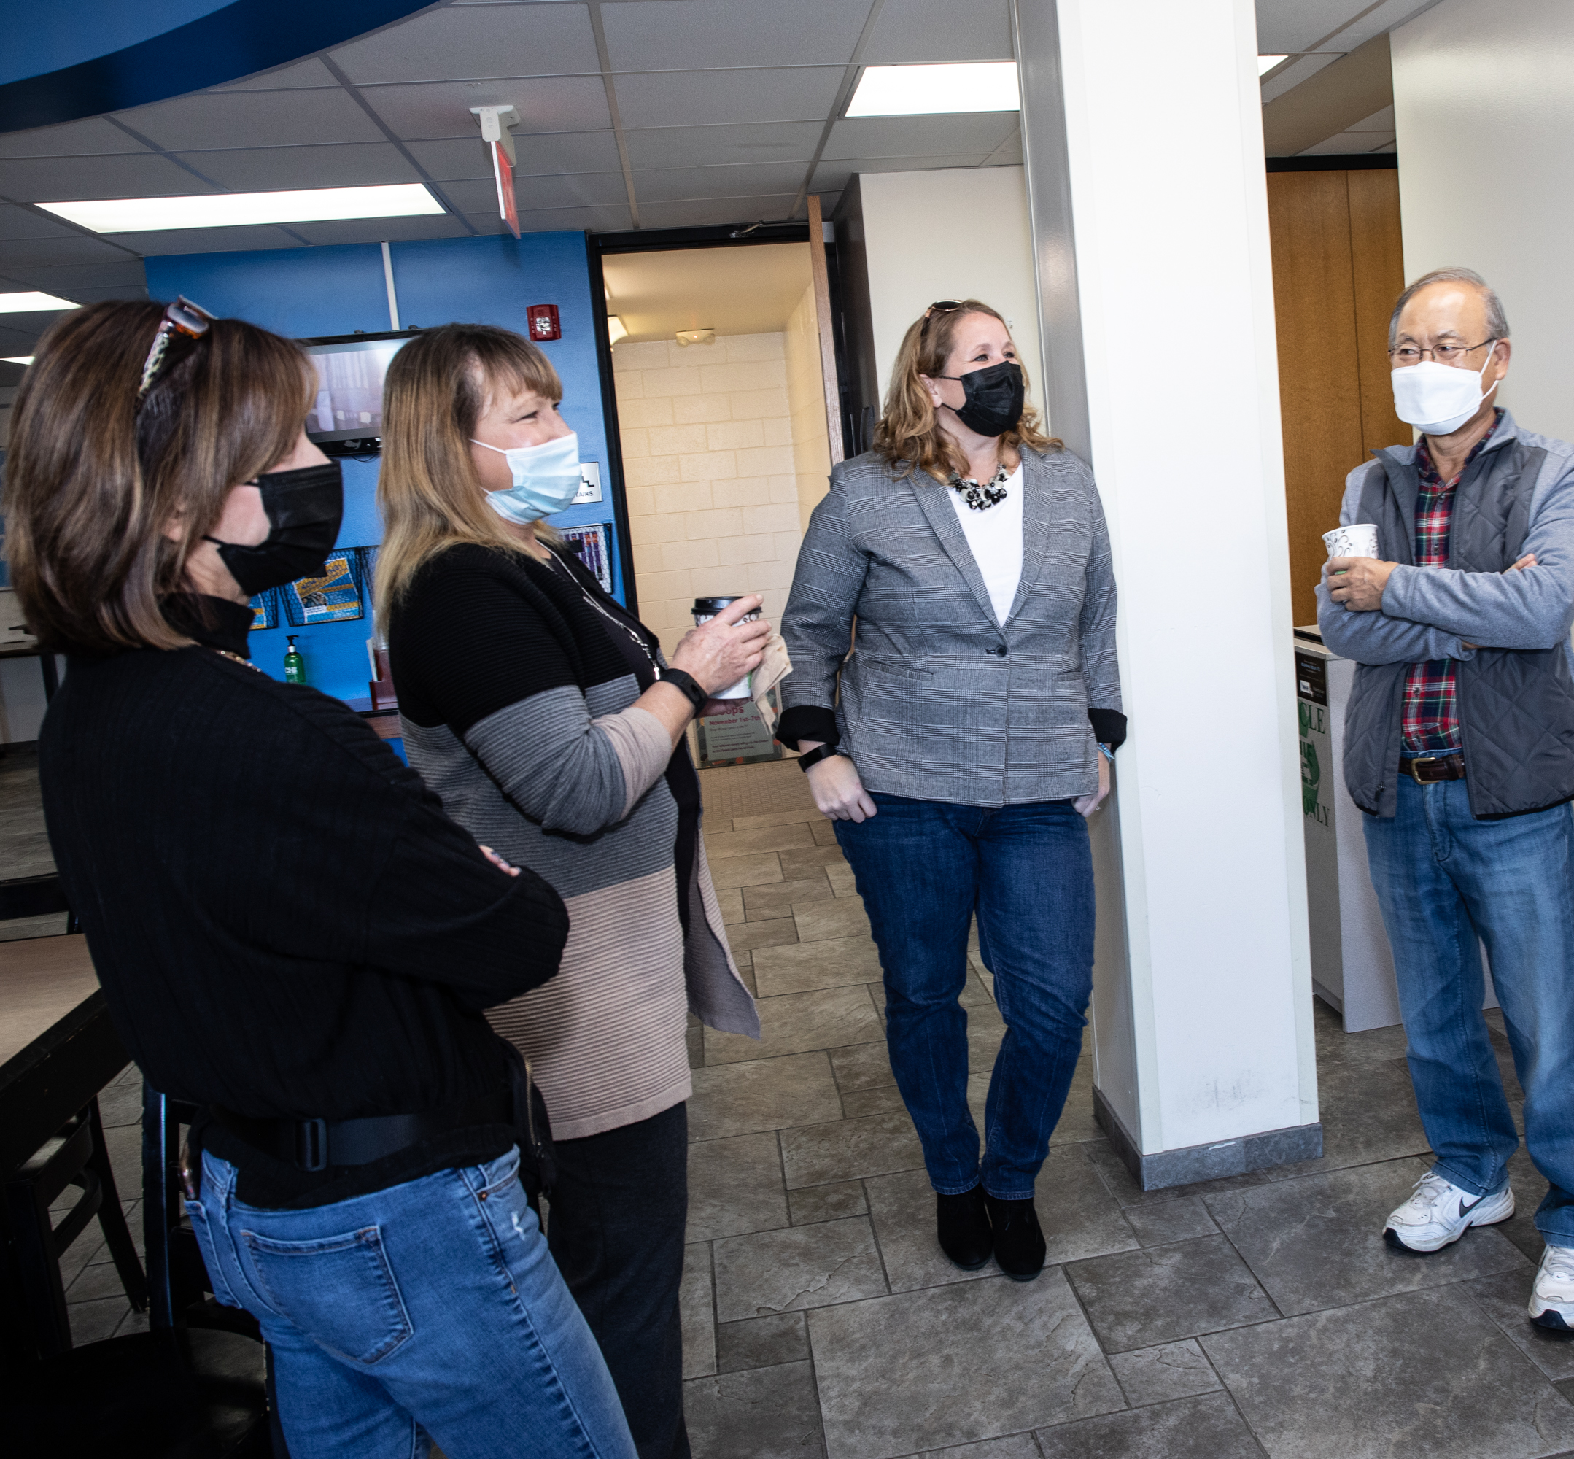
Engage your participants
Notes:
Create an interactive learning experience by using polls, discussions, and breakout rooms. Ask participants to respond to questions using the chat or question and answer features. Your tech support person or backup facilitator can monitor the chat or take polls.

Slide 22

Use PowerPoint with thoughtfully
Notes:
Use slide presentations to help participants focus and to strengthen your connection with your audience. But take care not to let it get in the way of that connection. When it’s time for participants to discuss a topic or ask questions, close your presentation so you can see and interact with them.
As you prepare for your event, practice turning the screen-sharing function on and off so you can do so easily during your presentation.

Slide 23

Announce the event schedule in advance
Notes:
Setting dates and announcing them well in advance allows participants to reserve that time for the event. Don’t forget to set clear expectations for attendance.

Slide 24

Choose technology that’s easy
to use
Notes:
Test any technology that you’re considering using before you purchase it. If you choose new technology, offer assistance to participants and make sure that facilitators, speakers, and tech support staff have time to rehearse before the event.

Slide 25

Set norms and expectations before the meeting starts
Notes:
Protocol and etiquette should be consistent for every meeting. Take time to communicate norms such as keeping microphones muted, turning on cameras, and using the chat or raising a hand to ask a question. At the start of each meeting or session, review how you want attendees to participate.

Slide 26
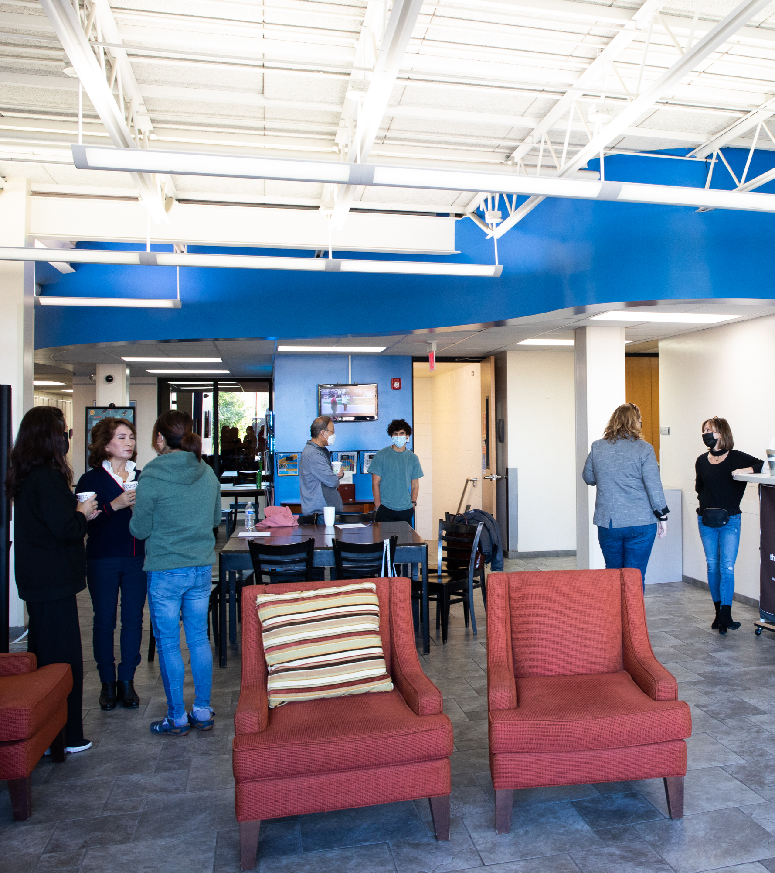
Plan time for unstructured networking
Notes:
Finally, we learned that when we plan virtual or hybrid events, it’s important to make time for unstructured networking. When you give participants information about upcoming events, tell them that they can sign in 15 minutes early to chat and test their audio and that you will keep the event open for 30 minutes after the official end so that people can continue their discussions.
It’s also important to provide a way to share ideas, whether that’s a virtual event platform, a Facebook page, or a learning topic in the Learning Center where participants can post content. Whatever you choose, make sure that participants will be able to get to it easily, and make it more inclusive by offering opportunities to participate that are straightforward and simple.

Slide 27
QUESTIONS?

